Slide 1
Advanced Applications development for Mobile Devices
Advanced UI with Paging and Swiping
Fall 2019
Week 03

Slide 2
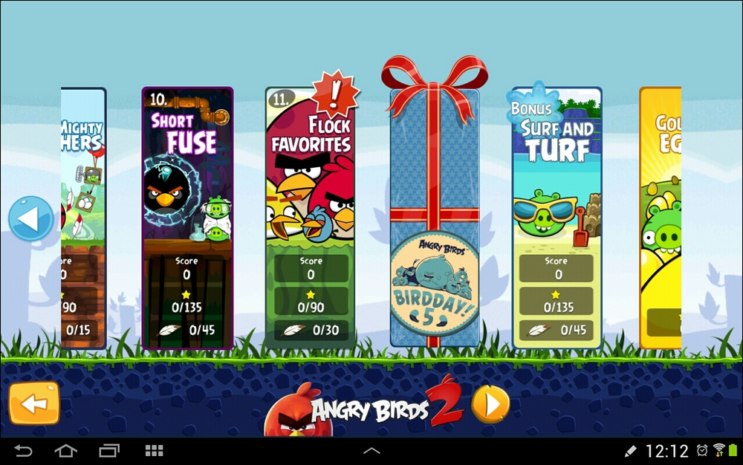
ViewPager

Slide 3
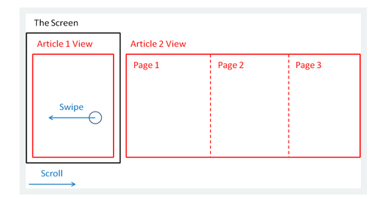
ViewPager
Paging is the act of moving from page to page, and, on Android, we do this by swiping a finger across the screen. The current page then transitions in a direction and speed to match the finger movement. It is a useful and practical way to navigate around an app, but perhaps even more than this, it is an extremely satisfying visual effect for the user.
The ViewPager is a layout widget that lets you implement gestural navigation.

Slide 4
ViewPager, cont.
ViewPager provided by android support library (yes, again!)
Using the ViewPager requires knowledge of both Fragments and PageAdapters.
In this case, Fragments are "pages". Each screen that the ViewPager allows the user to scroll to is a Fragment. By using Fragments instead of a View here, we're given a much wider range of possibilities to show in each page.
We can think of PageAdapters in the same way that you think of ListAdapters or RecycleView Adapters. The adapter used here is conceptually similar to that used by RecyclerView – you supply an implementation of PagerAdapter to generate the pages that the ViewPager displays to the user.

Slide 5
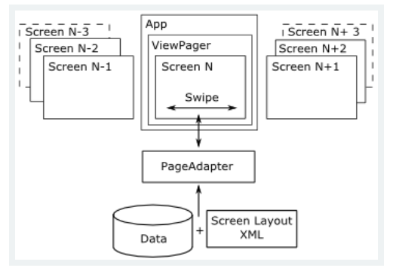
ViewPager, cont.
So, for all this to work we need:
An Activity with a ViewPager on display as part of its main UI.
A set of Fragments to be used as pages.
A custom FragmentPagerAdapter that returns the correct Fragment for each page number.

Slide 6
ViewPager Demo 1 with Fragments (Java)

Slide 7
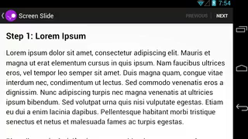
ViewPager Demo 1
This lesson shows you how to do screen slides with a ViewPager provided by the support library. ViewPager objects can animate screen slides automatically. Here's what a screen slide looks like that transitions from one screen of content to the next:

Slide 8
Steps to implement ViewPager
Steps for implementing ViewPager: 1) Create the view for Fragment
2) Create a Fragment class that returns the layout that you just created
3) Create a layout that contains ViewPager for the MainActivity
4) In MainActivity, set the content view to be the layout with the ViewPager.

Slide 9
Steps to implement ViewPager
Steps for implementing ViewPager, continue:
5) Creates a class that extends the FragmentStatePagerAdapter abstract class and implements the getItem() method to supply instances of ScreenSlidePageFragment as new pages. The pager adapter also requires that you implement the getCount() method, which returns the amount of pages the adapter will create (five in this example). 6) Hooks up the PagerAdapter to the ViewPager.
7) Customize the animation using PageTransformer
All steps:
https://developer.android.com/training/animation/screen-slide

Slide 10
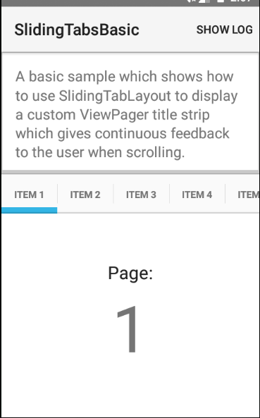
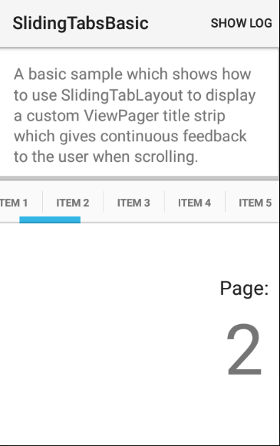
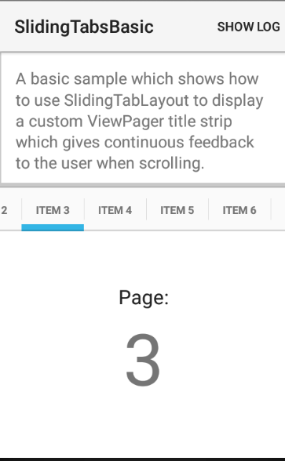
ViewPager Demo 1
Check: android-SlidingTabsBasic-master.zip on-line

Slide 11
ViewPager Demo 2 (Kotlin)

Slide 12
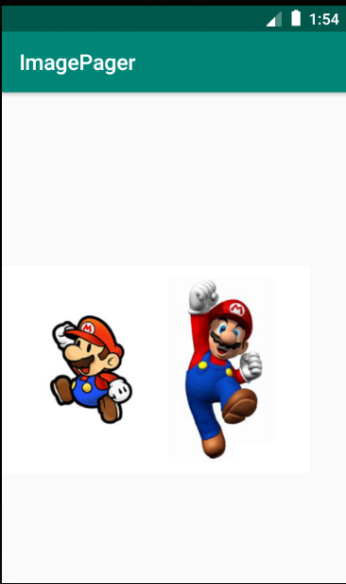
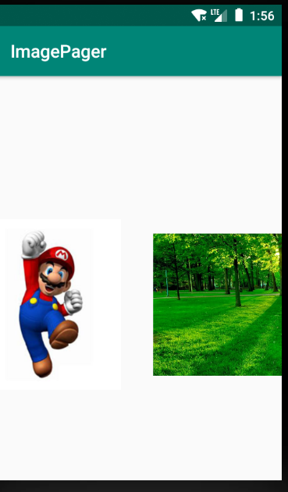

ViewPager Demo 2
This lesson shows you how to do screen slides with a ViewPager using Kotlin. Here's what a screen slide looks like that transitions from one screen to the next, with different images.
Check: ImagePager.zip on-line

Slide 13
ViewPager Demo 3 with Fragments (Kotlin)

Slide 14
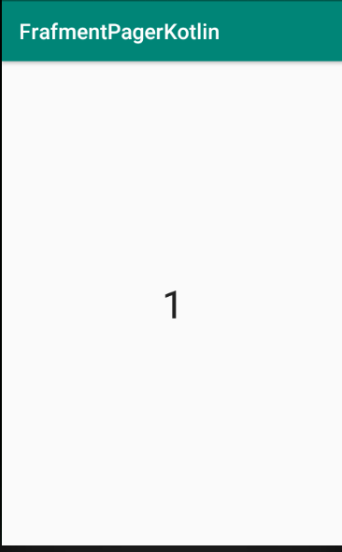
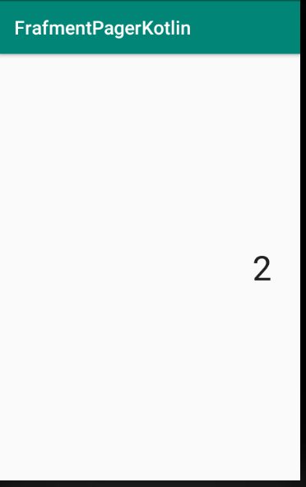
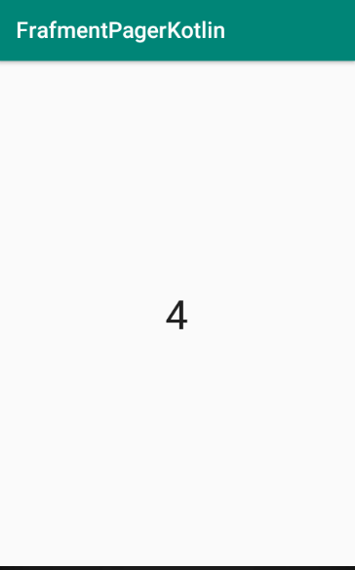
ViewPager Demo 3
This lesson shows you how to put whole Fragment instances as pages in a PagerAdapter.
To keep the code short and straightforward, we will add a single TextView to each Fragment layout, just to demonstrate that the pager is working. When we see how easy it is to get a reference to the TextView, however, it should be obvious how we could easily add any layout we have learned so far and then let the user interact with it.
Check: FrafmentPagerKotlin.zip on-line

Slide 15
In class activity
Read a document on-line to follow instructions for Demo 1:
https://developer.android.com/training/animation/screen-slide
Check zip-project 1 on-line
Follow instructions and check the Demo 2
Check zip-project 2 on-line Check zip-project 3 on-line

Slide 16
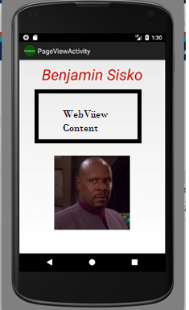
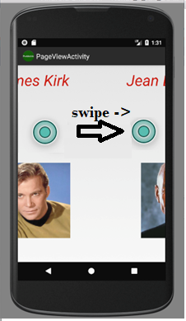
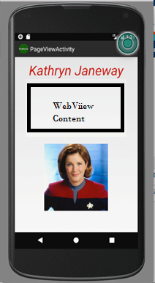
Assignment (use the same theme from previous lab)
Individual work to complete:
Update GUI to have text and picture to each of five fragments.

Slide 17
References
https://www.bignerdranch.com/blog/implementing-swipe-to-refresh/
https://developer.android.com/training/animation/screen-slide
https://medium.com/@ipaulpro/drag-and-swipe-with-recyclerview-b9456d2b1aaf
https://developer.android.com/training/material/theme.html
https://chris.banes.me/2014/10/17/appcompat-v21/
https://github.com/shamanland/floating-action-button
http://stackoverflow.com/questions/24459352/how-can-i-add-the-new-floating-action-button-between-two-widgets-layouts
http://treyrobinson.net/blog/android-l-tutorials-part-3-recyclerview-and-cardview/
https://developer.android.com/training/material/lists-cards.html

